Slide 1
Work Experience
Introduction
Jane Edwards
Work Experience and Employer Engagement
Co-ordinator

Slide 2
Introduction
All students are required to have completed an ‘experience of the workplace’ by the time you leave college.
There is no set amount of time - it can be a short work shadowing placement or an ongoing (unpaid) position that lasts all year.
It should ideally be in addition to your part-time job / own business.
Work experience gives people a clearer understanding of careers, builds confidence, and strengthens future job or education applications. It helps individuals develop practical skills, expand their network, and stand out to employers.

Slide 3
Key Benefits of Work Experience
🧭 Clarifies Career Direction
💼 Builds Practical and Transferable Skills
📈 Improves Employability
🤝 Expands Your Network
💪 Boosts Confidence and Work Habits
🌍 Shows Motivation and Commitment
Notes:
🧭 Clarifies Career Direction
Helps you try out career ideas and rule out options.
Offers insight into a job, company, or sector so you can decide your next steps.
💼 Builds Practical and Transferable Skills
Develops soft skills such as teamwork, communication, and problem‑solving.
Provides hands‑on experience that complements academic learning.
Shows employers you can apply skills in real settings—especially important in fields like the creative industries.
📈 Improves Employability
Employers value relevant experience: two‑thirds look for graduates who have it because it demonstrates readiness for work and business awareness.
Gives you evidence of your abilities for CVs, applications, and interviews.
🤝 Expands Your Network
Introduces you to new people and professional contacts who may help with future opportunities.
💪 Boosts Confidence and Work Habits
Helps you adjust to routines and expectations of working life, which can significantly improve employment prospects—especially for those with little or no work history.
Encourages you to challenge yourself and overcome difficulties, such as communicating with new people.
🌍 Shows Motivation and Commitment
Demonstrates to employers or education providers that you are proactive and genuinely interested in a particular field.

Slide 4


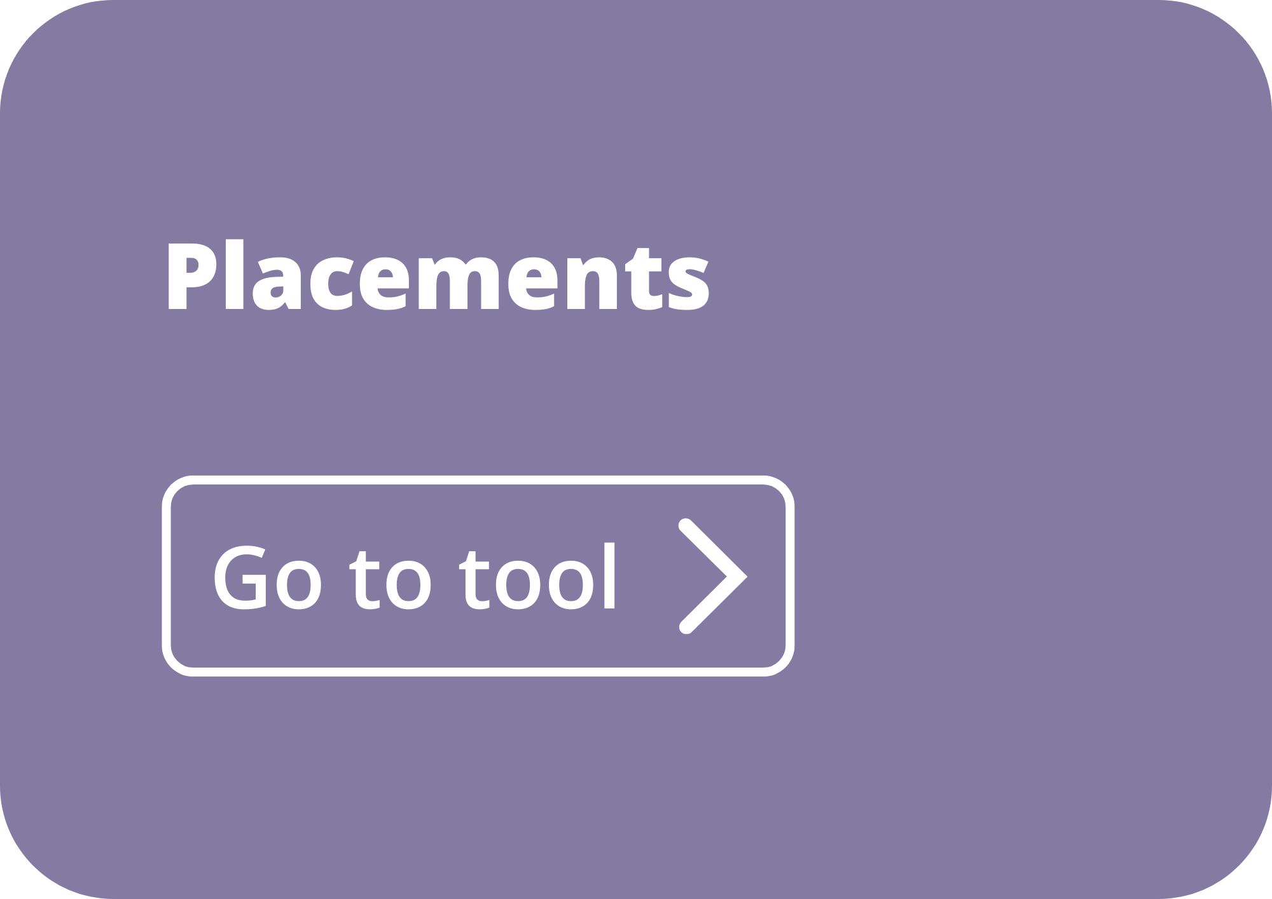

Key information
Recommended time for Work experience:
Futures Season (June 2026)
Half-term holidays – February/May
Easter holidays
Summer holidays
.
In-person WEX - You must enter this on the work placement tool on Unifrog in advance.
Virtual WEX – Please inform careers and we will send you the necessary paperwork.
In-person - You must agree your placement with the employer using the Placements tool on Unifrog.
It’s your responsibility to find a placement. We can support you, but we can’t do it for you.
Notes:
Teacher’s notes:

Slide 5
Examples of work experiences
Work shadowing placement
Online/Virtual interactive work experience – with employer interaction (hybrid)
Voluntary work – where you are completing tasks / gaining skills within a workplace and meeting with a number of employees

Slide 6
How do you find in person work experience?
We can support you, but it’s your responsibility to find a placement!
Contact local businesses
(e.g. shops)
Talk to local services (e.g. the library, the council office, museums, etc.)
Talk to friends and family who have businesses
Talk to the clubs you belong to outside of school (e.g. Scouts, sports teams, etc.)
Contact nurseries and primary schools
Contact the local branch of a chain company (e.g. Tesco)
Notes:
Teacher’s notes:
Add in relevant examples where the red text is.
Some placements need to have Employer’s Liability Insurance. Please stress this to students.

Slide 7
Think “outside the box”
You may want experience in specialist areas, or industries inaccessible to under 18s
Do other companies have departments that work in that area?
Do other employers/jobs utilise skills important to your area of interest?
e.g. Do larger companies have legal departments or accounts teams for law or accounting experience?
HR departments or social workers might offer an insight into areas of psychology?
Healthcare areas look for experience in care settings, care homes, working with the vulnerable?

Slide 8





How do you find virtual work experience?
There are many websites that offer virtual work experience. Some programs are available on-demand, while others run at scheduled times.
Notes:
Teacher’s notes:
Add in relevant examples where the red text is.
Some placements need to have Employer’s Liability Insurance. Please stress this to students.

